Slide 1
Image and Video Processing

Slide 2
考核
随堂测验 13周
2. 期末大作业：Image-to-Image Translation
(1) 最多4人一组
(2) 口头汇报14-15周
PPT+程序演示，时间8-10分钟
(3) 提交材料16周周日
论文+代码+PPT
(4) 成员贡献明确，且按贡献排序

Slide 3
Image-to-Image Translation
translating one possible representation of a scene into another, given sufficient training data
Notes:
风格图是富春山居图

Slide 4

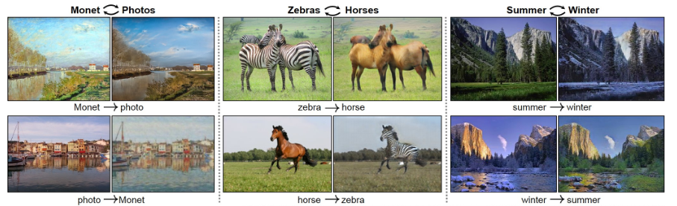

Slide 5
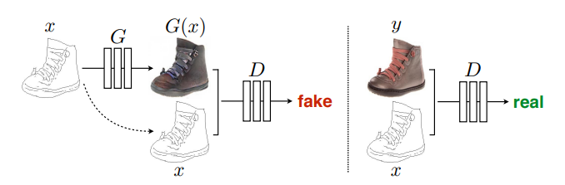
Image-to-Image Translation with Conditional Adversarial Networks
this approach is effective at synthesizing photos from label maps, reconstructing objects from edge maps, and colorizing images, among other tasks

Slide 6
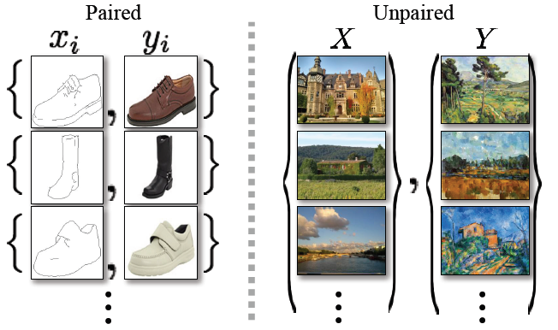
Unpaired Image-to-Image Translation using Cycle-Consistent Adversarial Networks
An approach for learning to translate an image from a source domain X to a target domain Y in the absence of paired examples

Slide 7
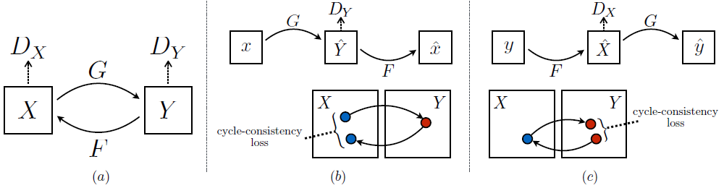
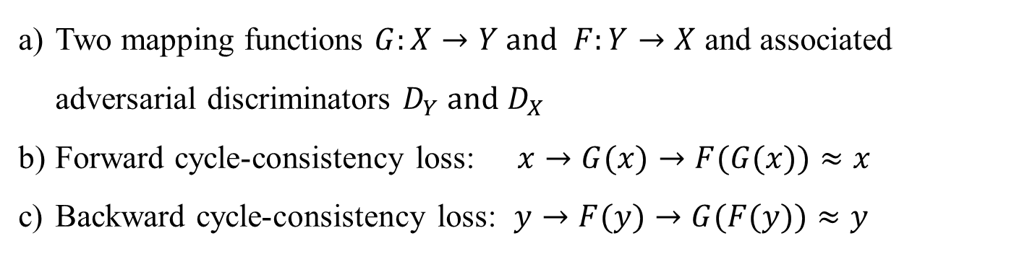
Unpaired Image-to-Image Translation using Cycle-Consistent Adversarial Networks
Two mapping functions $G:X→Y and F:Y→X$ and associated adversarial discriminators $D_{Y} and{ D}_{X}$
Forward cycle-consistency loss: $x→G(x)→F(G(x))≈x$
Backward cycle-consistency loss: $y→F(y)→G(F(y))≈y$

Slide 8
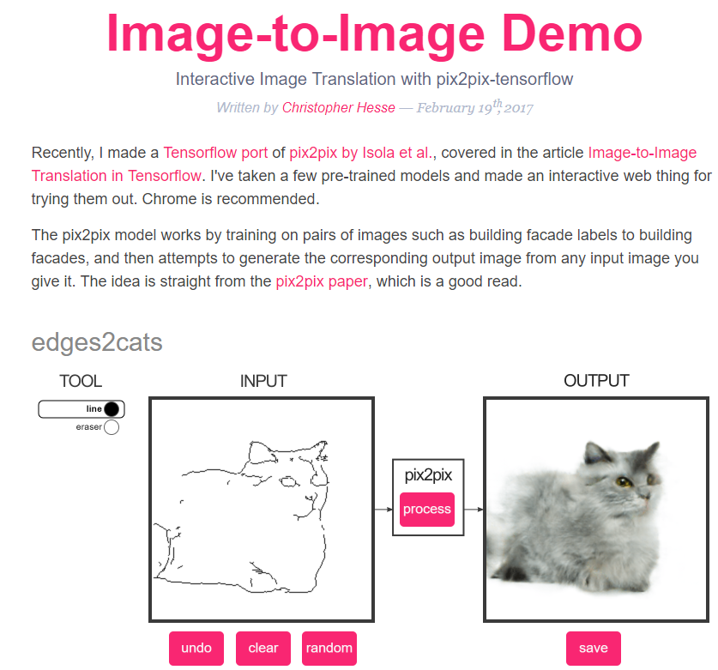
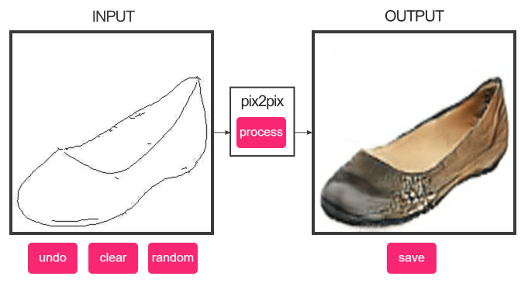
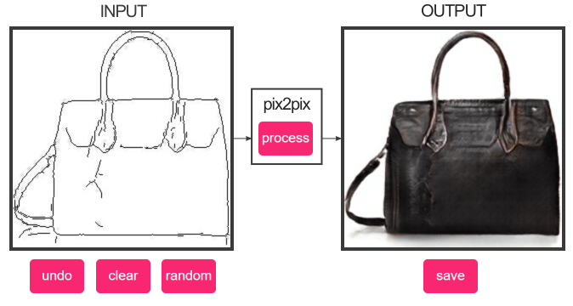
An interesting image-to-image translation website
[https://affinelayer.com/pixsrv/]

Slide 9
Some materials
Survey, papers and codes: https://github.com/weihaox/awesome-image-translation

Slide 10
III.3 Morphological Filtering for Image Enhancement and Detection
1 Introduction
2 Morphological Image Operators
3 Morphological Filters for Enhancement
4 Morphological Filters for Detection

Slide 11
1 Introduction
The goals of image enhancement
Improve the visibility and perceptibility of the various regions into which an image can be partitioned and detectability of the image features inside these regions
Cleaning the image from various types of noise
Enhancing the contrast among adjacent regions or features
Simplifying the image via selective smoothing or elimination of features at certain scales
Notes:
改善可将图像分割成的各个区域的可见性和可感知性，并改善这些区域内部的图像特征的可检测性
清除图像上的各种噪音
增强相邻区域或特征之间的对比度
通过选择性平滑或消除某些比例的特征来简化图像

Slide 12

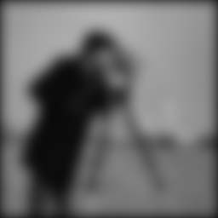
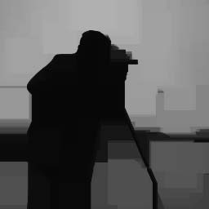
1 Introduction
original
Gaussian Linear convolutions
Morphological clos-openings
Mathematical morphology
A set- and lattice-theoretic methodology for image analysis, which aims at quantitatively describing the geometrical structure of image objects
Notes:
集和格理论的图像分析方法，旨在定量描述图像对象的几何结构

Slide 13
1 Introduction
Morphological image processing
A broad and coherent collection of theoretical concepts, nonlinear filters, design methodologies, and applications systems
Preserve, uncover, or detect the geometric structure of image object
Offer efficient solutions to other nonlinear tasks such as non-Gaussian noise suppression

Slide 14
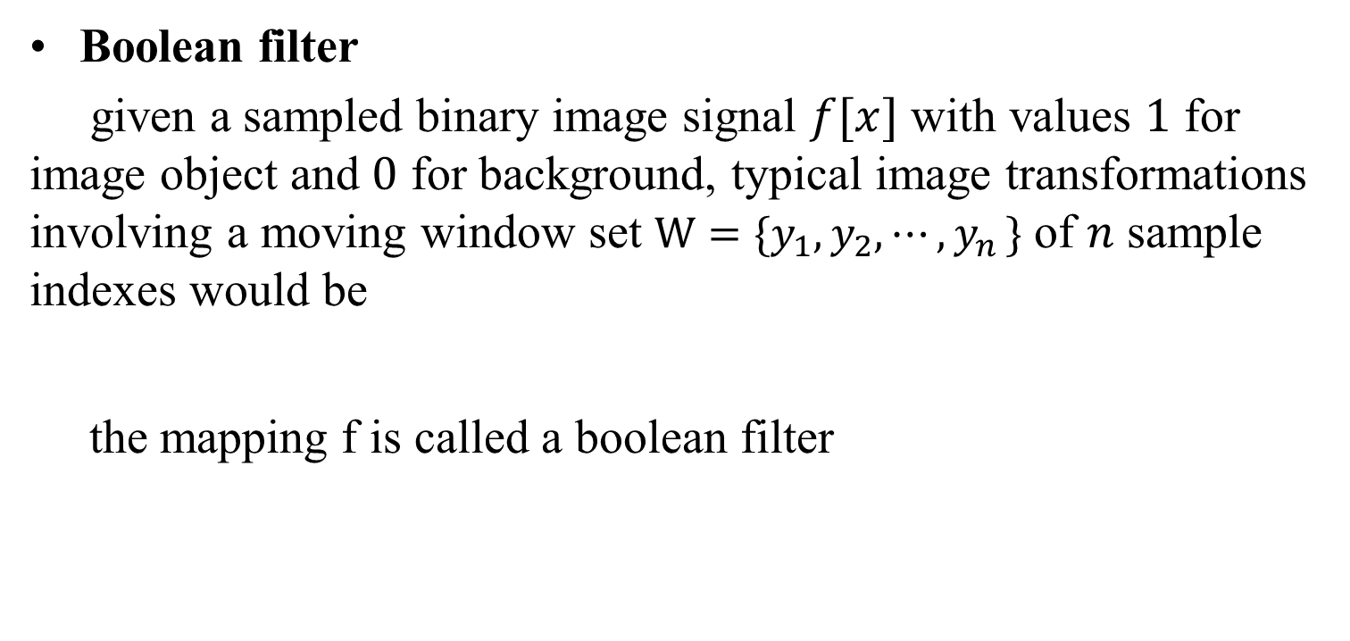
2 Morphological Image Operators 2.1 Morphological Filters for Binary Images
Boolean filter
given a sampled binary image signal $f[x]$ with values $1$ for image object and $0$ for background, typical image transformations involving a moving window set $W=\{y_{1},y_{2},⋯{,y}_{n}\}$ of $n$ sample indexes would be
the mapping f is called a boolean filter

Slide 15
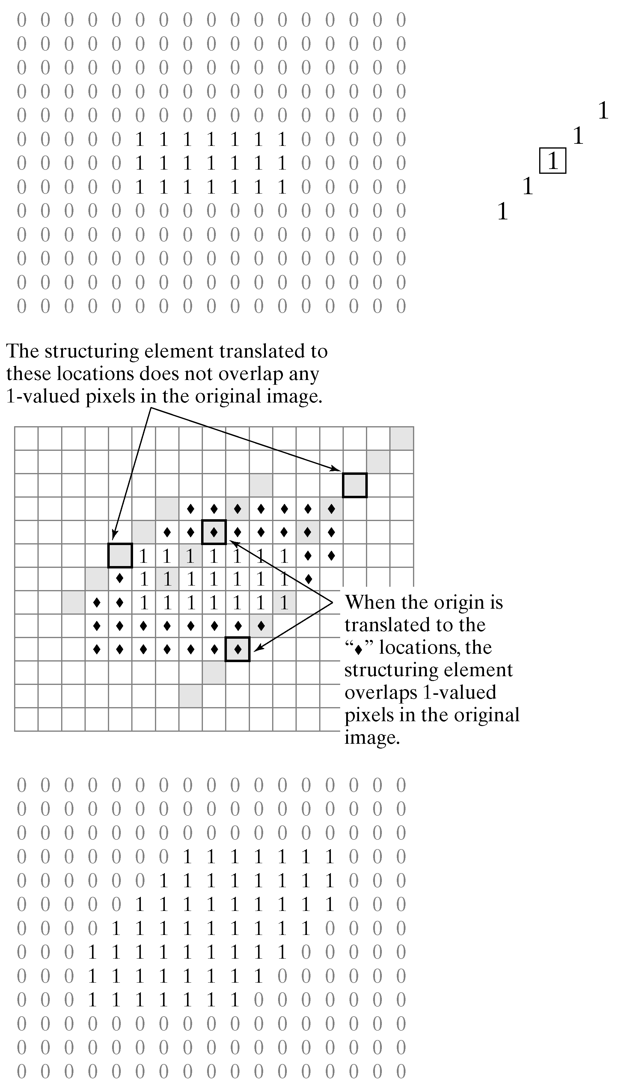
2 Morphological Image Operators 2.1 Morphological Filters for Binary Images
Dilation
the Boolean OR transformation of X by a (window) set B
where is the translation of X along the vector y
Notes:
Di’lation: 扩大、膨胀操作

Slide 16
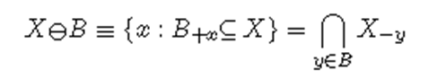
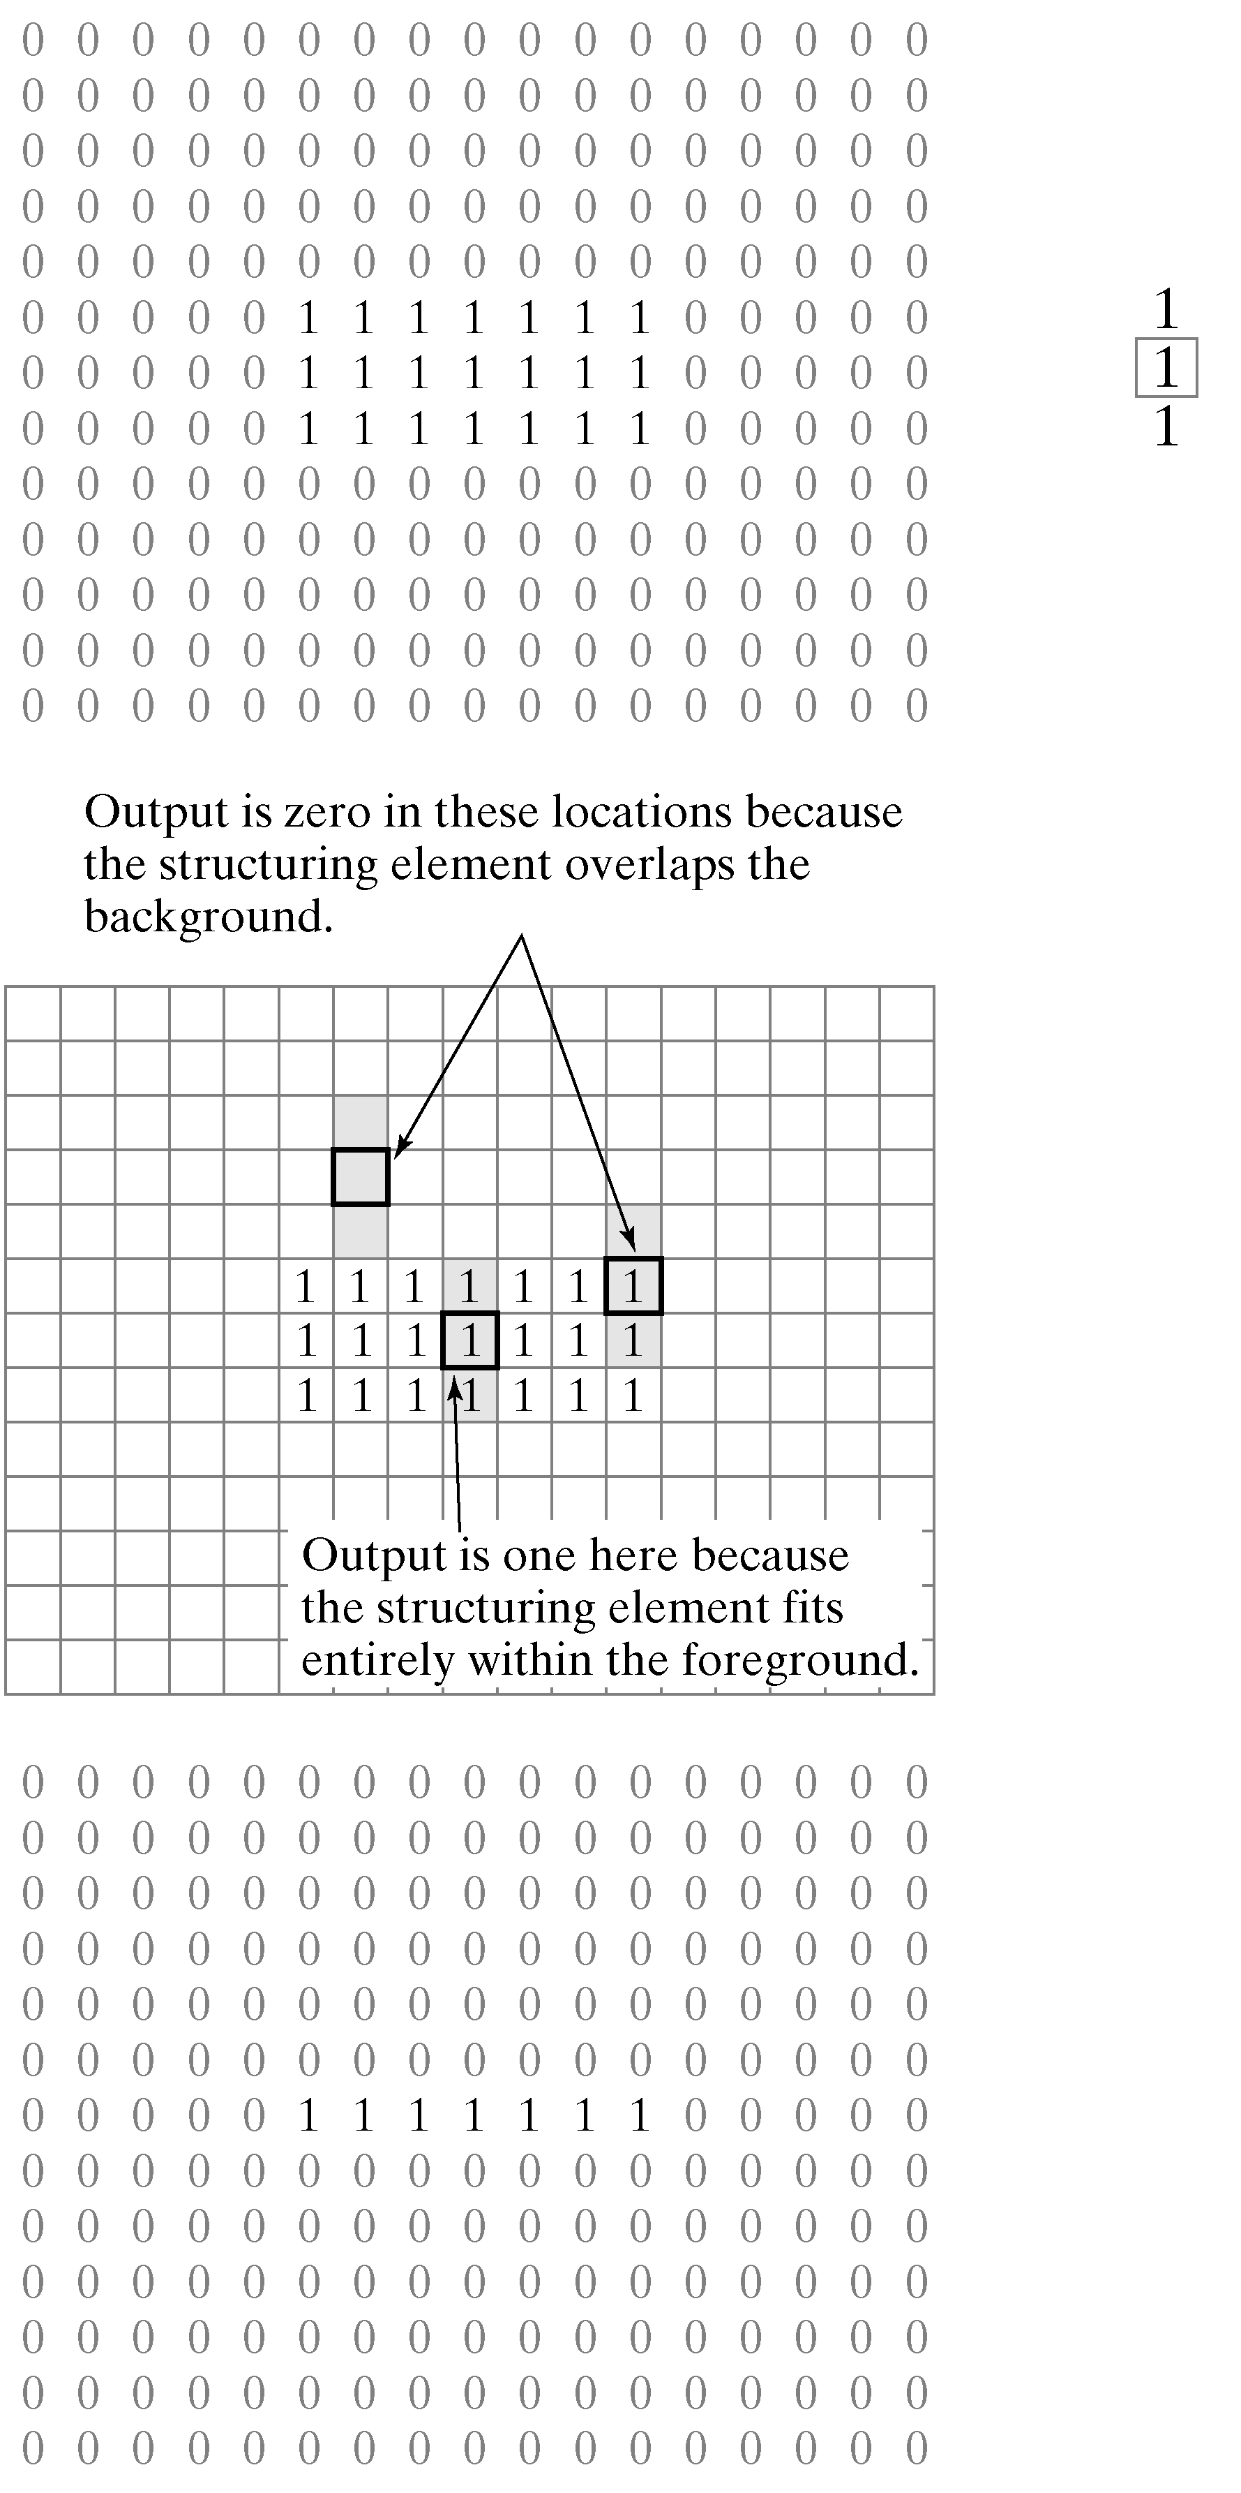
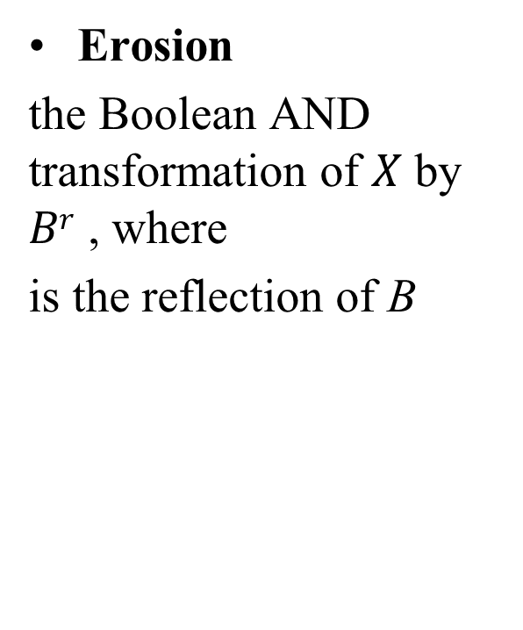
2 Morphological Image Operators 2.1 Morphological Filters for Binary Images
Erosion
the Boolean AND transformation of $X$ by $Br$ , where
is the reflection of B
Notes:
E’rosion: 腐蚀操作

Slide 18
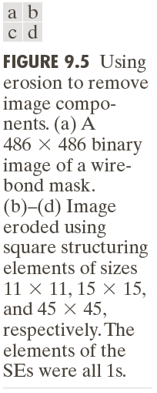

Slide 19
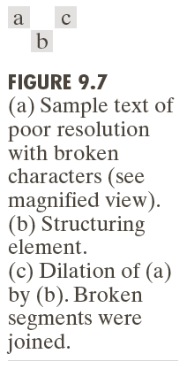

Slide 20
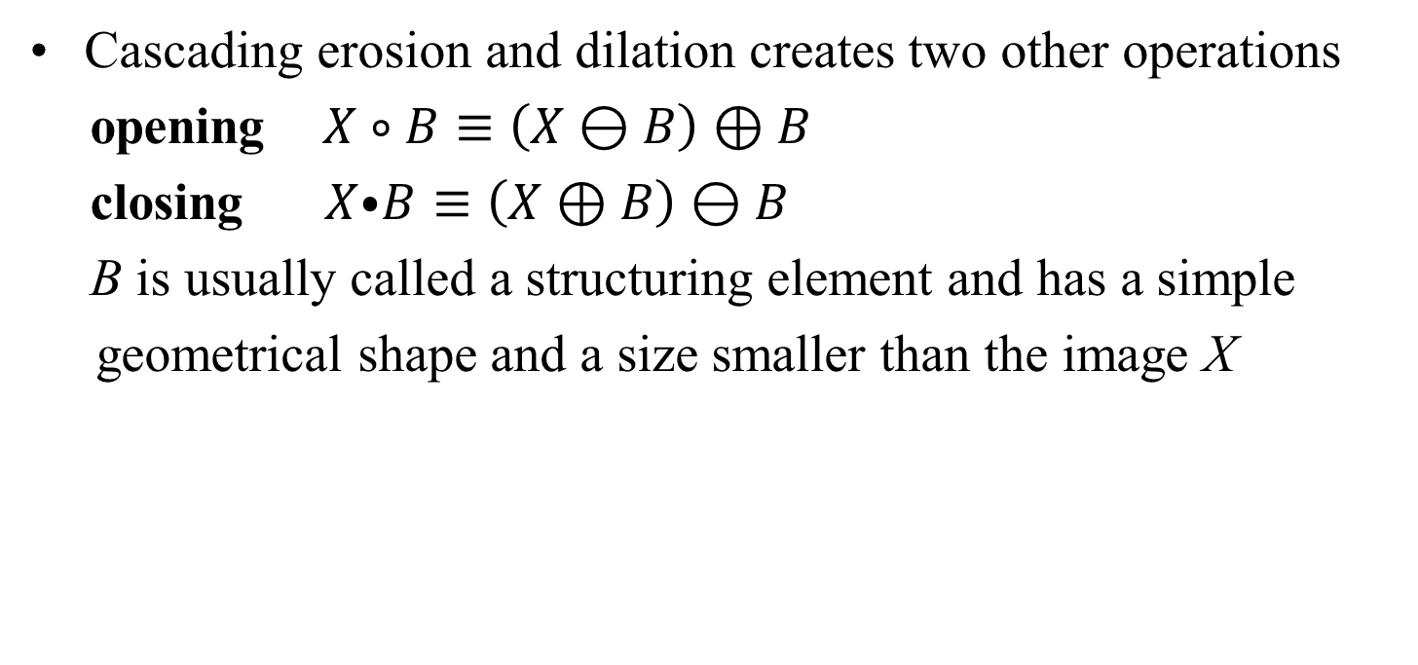
2 Morphological Image Operators 2.1 Morphological Filters for Binary Images
Cascading erosion and dilation creates two other operations
opening $X∘B≡\left(X⊖B\right)⊕B$
closing $X⦁B≡\left(X⊕B\right)⊖B$
B is usually called a structuring element and has a simple
geometrical shape and a size smaller than the image X

Slide 21
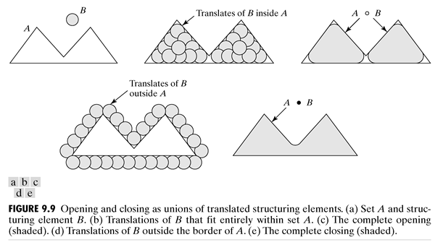
2 Morphological Image Operators 2.1 Morphological Filters for Binary Images

Slide 22
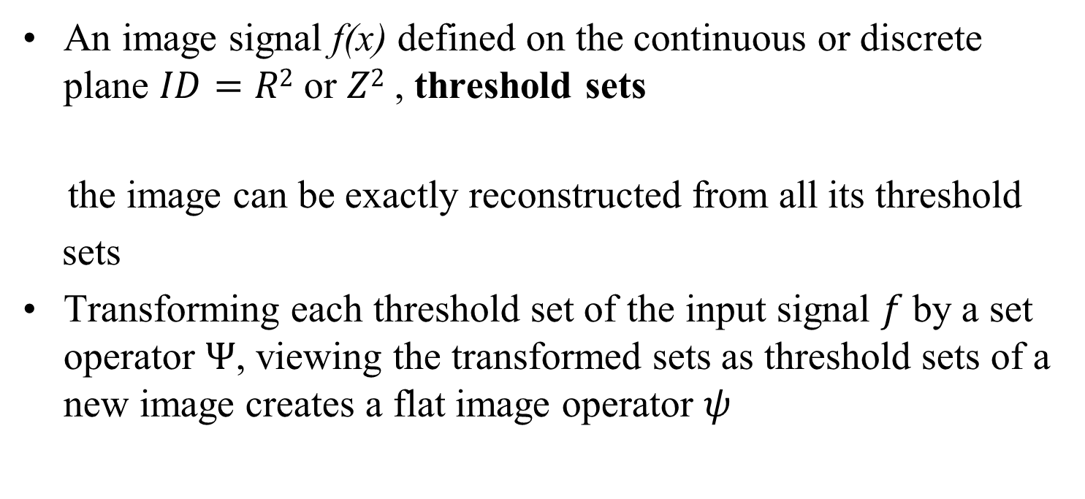
2 Morphological Image Operators 2.2 Morphological Filters for Graylevel Images
An image signal f(x) defined on the continuous or discrete plane $ID=R2$ or $Z2$ , threshold sets
the image can be exactly reconstructed from all its threshold
sets
Transforming each threshold set of the input signal $f$by a set operator $Ψ$, viewing the transformed sets as threshold sets of a new image creates a flat image operator $ψ$

Slide 23
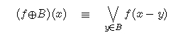
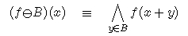
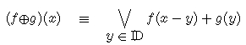
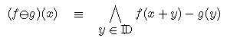
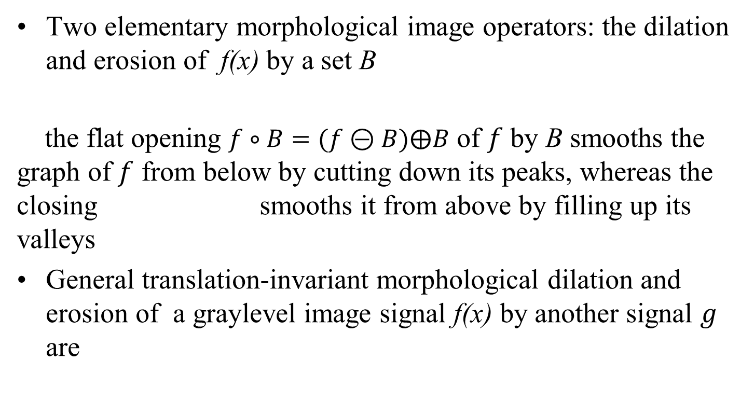
2 Morphological Image Operators 2.2 Morphological Filters for Graylevel Images
Two elementary morphological image operators: the dilation and erosion of f(x) by a set B
the flat opening $f∘B=(f⊝B)⨁B$ of $f$ by B smooths the graph of $f$ from below by cutting down its peaks, whereas the closing smooths it from above by filling up its valleys
General translation-invariant morphological dilation and erosion of a graylevel image signal f(x) by another signal $g$ are

Slide 24
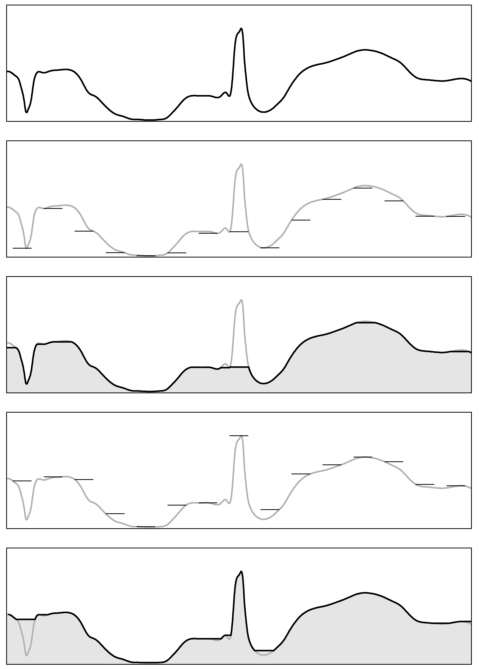
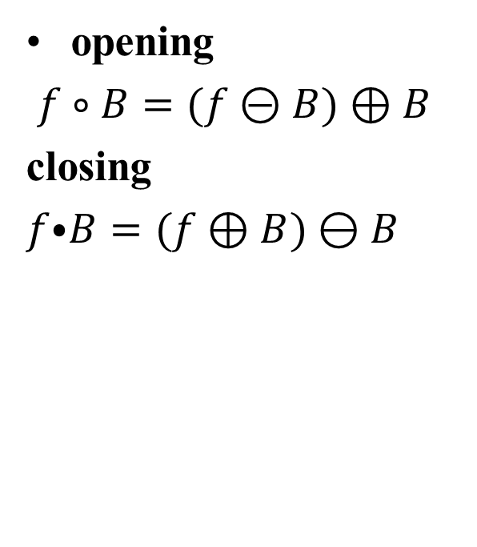
2 Morphological Image Operators 2.2 Morphological Filters for Graylevel Images
opening
$f∘B=(f⊝B)⊕B$
closing
$f⦁B=(f⊕B)⊖B$

Slide 25
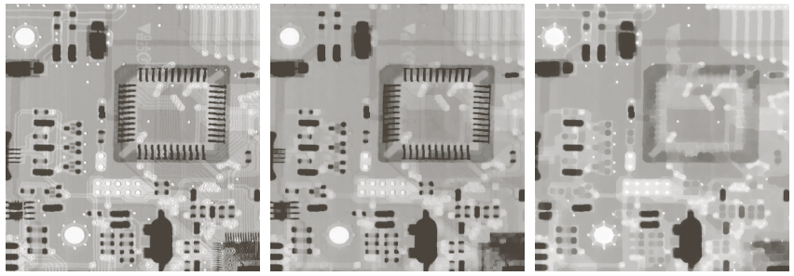
2 Morphological Image Operators 2.2 Morphological Filters for Graylevel Images

Slide 26
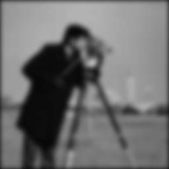


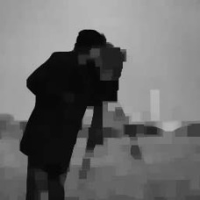
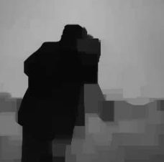

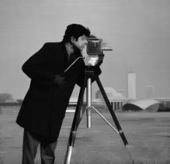
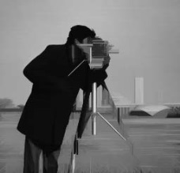
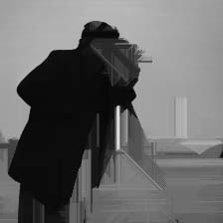
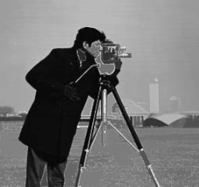
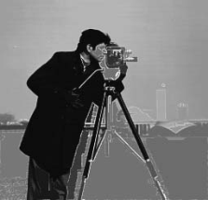
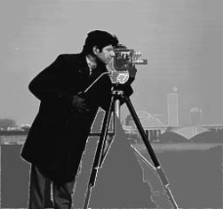
3 Morphological Filters for Enhancement 3.1 Image Smoothing or Simplification
Multiscale Morphological Smoothers
Gaussian linear convolutions
Morphological clos-openings
Morphological radial clos-openings
Morphological clos-openings by reconstruction
Scale=8
Scale=16
Scale=32

Slide 27
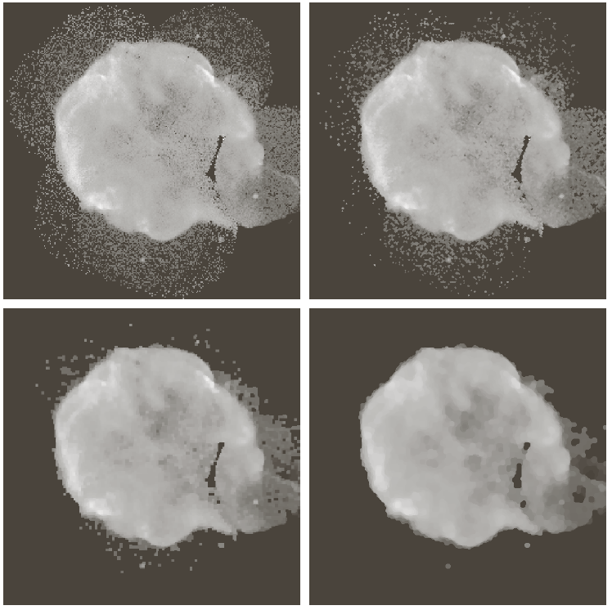
3 Morphological Filters for Enhancement 3.1 Image Smoothing or Simplification

Slide 28
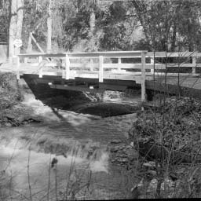



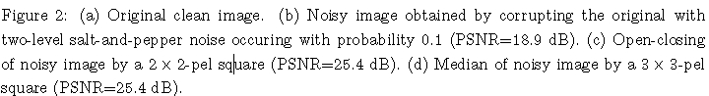
3 Morphological Filters for Enhancement 3.1 Image Smoothing or Simplification
Noise Suppresion by Median and Alternating Sequential Filters
(a)
(b)
(c)
(d)

Slide 29
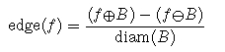
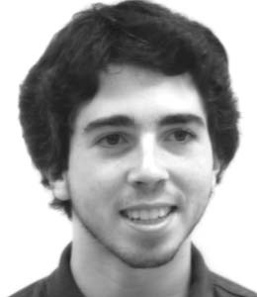
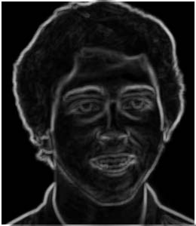
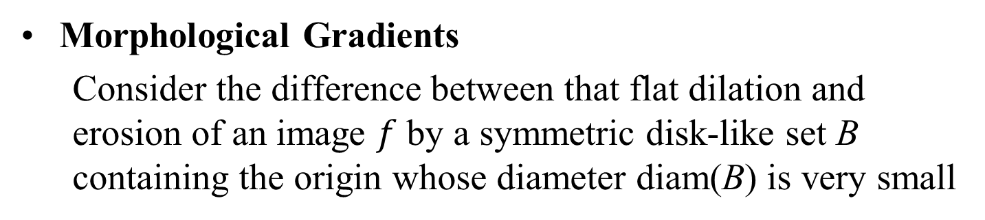
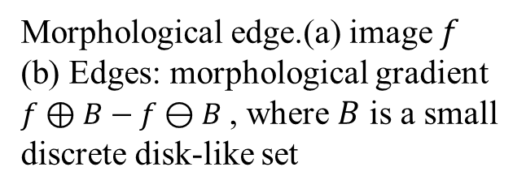
3 Morphological Filters for Enhancement 3.2 Edge or Contrast Enhancement
Morphological Gradients
Consider the difference between that flat dilation and erosion of an image $f$ by a symmetric disk-like set B containing the origin whose diameter diam(B) is very small
Morphological edge.(a) image $f$ (b) Edges: morphological gradient $f⊕B−f⊖B$ , where $B$ is a small discrete disk-like set
(a)
(b)

Slide 30
3 Morphological Filters for Enhancement 3.2 Edge or Contrast Enhancement

Slide 31
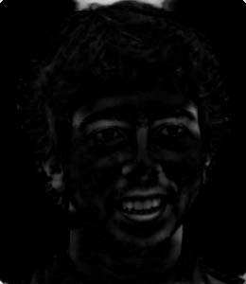
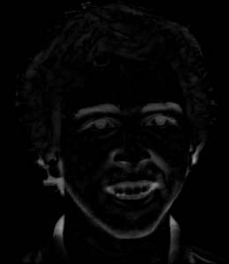
4 Morphological Filters for Detection Morphological Peak/Valley Feature Detection
Residual between opening or closings and the original image offer an intuitively simple and mathematically formal way for peak or valley detection
Top-hat transformation:
Valley detector:
(a)
(c)
(d)
Morphological blob detectors. (a) image $f$ (c) Peaks: $f−f∘B$ (d) Valleys : $f⦁B−f$
Notes:
打开或关闭与原始图像之间的残差提供了一种直观简单且数学形式化的方式来进行峰值或谷值检测

Slide 32
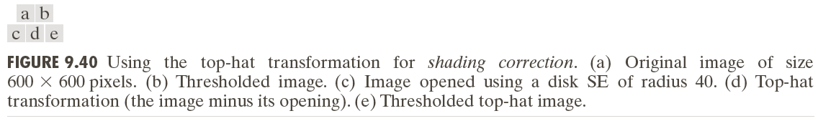
4 Morphological Filters for Detection Morphological Peak/Valley Feature Detection

